Slide 1
Projects

Slide 2
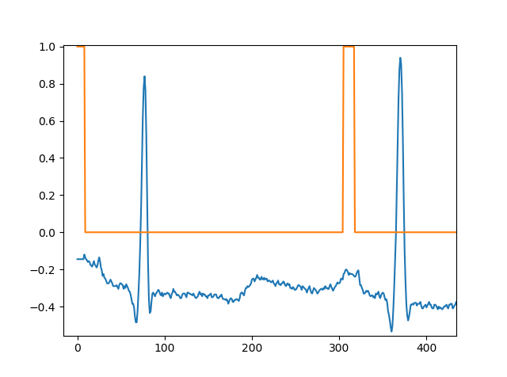
2. ECG
Data:
~1 h, 360 sps 1D signal + P wave annotation
Aim:
Create a 1D DNN to predict each sample's class (predicts for a single sample).
Create a 1D FCN to predict each sample's class for the whole crop.
Try receptive fields of 0.5, 1, and 2 periods. You might want to downsample the data
How would you measure the resulting performance?

Slide 3
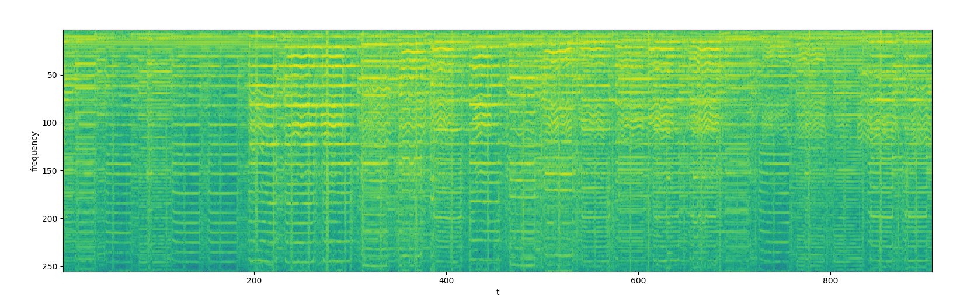
3. Music and Speech, DNN
Data:
Gtzan dataset, 64 of 30 sec samples, for each
Fourier transformed to 2d map of amplitudes for frequency vs time
Aim:
create 64 time-samples long patches with overlap of 32 from all music and speech files. assign labels accordingly
build a classifier net, (e.g. 4 convolutional layers, use stride of 2; and 2 fully connected layers). try different activation functions (relu, tanh, sigmoid).
Train on 80% of the data and validate on remaining 20, study the convergence.

Slide 4
5. MIDI generation, RNN
Data:
Any single instrument midi file or multiple files
Aim:
Build LTSM network, predicting next midi message (note on/off, note, velocity, delay – i.e. multiple outputs and loss functions)
Study performance & convergence depending on the number of used time steps (16-1024)
Total loss is weighted sum of the losses of each branch. How the weights affect model convergence?
Does the model generalize to different key (transposed melody)?
https://github.com/neworldemancer/midi_synth

Slide 5
4. Music and Speech, RNN
Data:
Gtzan dataset, 64 of 30 sec samples, for each
Fourier transformed to 2d map of amplitudes for frequency vs time
Aim:
Build LTSM network, where a cell predicts speech vs music
Same as in DNN, but feed sequentially the consecutive time samples
Study performance depending on the number of used time steps (5-32)

Slide 6
1. Spam detection - OBSOLETE
Dataset:
4.6k records, 1.8k spam
Columns, e.g. word_freq_make, word_freq_address, capital_run_length_average, etc.
Task:
build a fully connected classifier network that will classify the mails.
check which parameters affect decision the most (biggest gradient wrt to answer)
build a classifier that doesn't use 1, 2, 10 most significant parameters. Does it still perform better then random?

